Slide 1
The Enlisted Association Chapter 39
15821 E Centretech Cir
Aurora Co 80011
15821 E Centretech Cir
Aurora CO 80011
303-340-3939
July, August, and September 2022

Slide 2
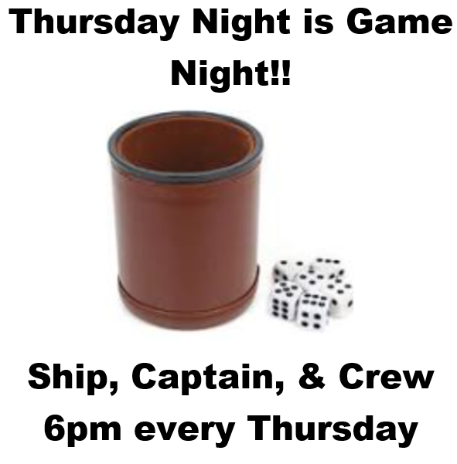
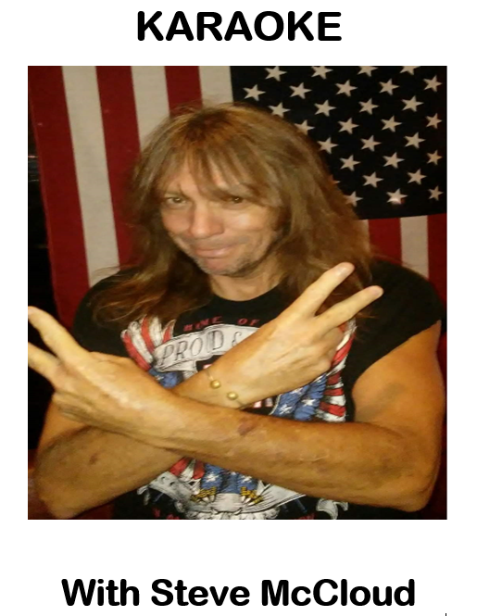
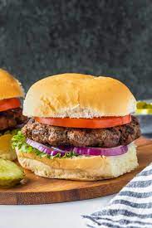
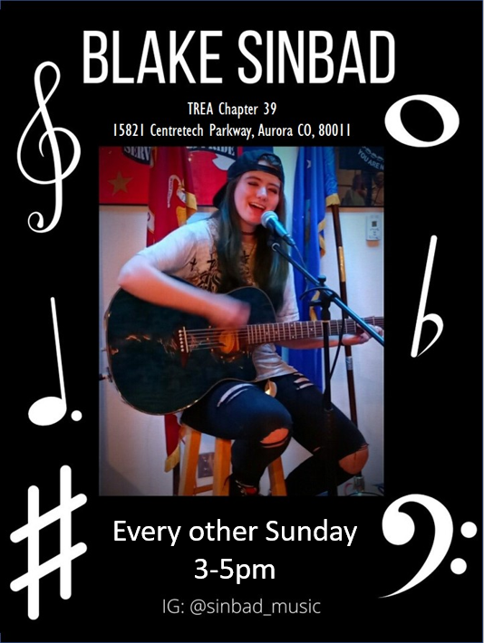
A WORD FROM THE PRESIDENT
THINGS TO DO AT CHAPTER 39
SEE CALENDARS FOR DETAILS
We had a very busy 2nd Quarter and I want to thank everyone who supported our Memorial Day Parade float building and participation in the parade. It was a lot of fun. Our annual Flag Retirement Ceremony was well attended, as have been several of our other events, thanks again.
I’m asking for your warm thoughts and prayers for our Chaplain, John Green. John is in the hospital with complications from his recent knee replacement surgery resulting in a fall and fractured shoulder and elbow.
We are now in the heat of the summer so come inside and share some camaraderie with your friends and fellow vets. And remember, if you don’t have something nice to say about someone it’s best to say nothing at all.
As always, go to our website at www.trea39.org for the most recent calendar and look for our events on our Facebook page. You can subscribe to my weekly “What’s Happening This Week at TREA 39” email for the latest scoop by sending me an email at president@trea39.org
Thank you,
Clarence “CJ” Johnson
25¢ per round
Bison Burger Dinner July 16th
A WORD FROM THE AUXILIARY
I want to thank everyone who purchase bake goods from our Auxiliary table at your dinners. We do appreciate it. The raffle for the St Patrick’s Day Basket was won by Zeb Jenkins. Thank you again. In August we are planning a wine tasting on Sunday the 21st from 1:00-3:00pm. Hope to see all our ladies. For fun and good food, $10 is well worth it. Our meetings for the Auxiliary is the 3rd Sunday of the month at 1:00pm. Do have a happy 4th of July.
United We Stand
Helen Suggs
Sip & Paint with Dani, July 17th 2-4pm
CHARITY REPORT
Hello Everyone!
Our 2022 goal is to raise $1,500 and as of June 1st, we have raised $1,300! Our charity recipients this year are: COMITIS Crisis Center, Veterans Community Living Center, Honor Bell, TREA Gives Program, Freedom Service Dogs, and Wreaths Across America. Our next fundraiser will be the Bison Burger Dinner on Saturday, July 16th!!
Christine Johnson
Treasurer
Queen of Hearts drawing every Saturday at 7:00pm.

Slide 3
MANAGER’S MINUTE
CHAPLAIN’S CORNER
Father John is currently recovering from surgery, and we ask that you keep him in your thoughts! He asks that we remember we are all friends and family and should be supporting each other. Ugly words or actions can cause huge rifts. We should be coming together instead of being divisive.
Taken from previous postings by John:
Taking a moment to thank everyone who has been coming in to support the club. It has been good to see everyone again. Let’s not forget, there are many ways to support your club: Come in for a drink (especially when we have entertainment), being part of the A&E committee, or donating supplies all help! Of course, we know you can’t be here all the time, but at least once a month to show support would be helpful. All in all, we are doing ok. But we can always do better by showing up and saying hello to long time friends.
God Bless you all. Be safe and love one another!
Father John Green
Greetings,
It has been great to see so many folks returning, but we’re still missing some friends. Please check out all the different activities on the attached calendars and come see us. The Activities and Entertainment Committee works very hard to plan events so that there is something for everyone. But that only happens if you share what you would like to see. Please either come to a meeting or contact a member of the committee to share your thoughts. The committee is open to ALL members, not just Chapter.
The summer months are here, please join us for a cold drink and warm friendship! We have a new band on July 2nd, Sisters of the Moon, and a taco bar for dinner. Please come let us know what you think of them. We’ll have our annual pre-fireworks BBQ for Independence Day from 2-5pm. The club will be providing burgers and hotdogs, please bring a side dish to share.
There are many fun events planned, please see the calendars attached and come out and see us. And as always, this is your Club, let me know what you’d like to see!
Charlie Keith
Club Manager
MEMBERSHIP REPORT
Hello Everyone!
Please make sure to update your information with TREA National for Chapter members and TREA Chapter 39 for club members. Having an email address on file is the best way for us to get information out to you. If you could email that info to me, it would be much appreciated: cjohnson720@msn.com
If you’re a “Club” member and haven’t been to the Club in a while, we are OPEN for business! If you would like to renew your membership, come in and fill out a new form. Membership is now $30 a year (additional $5 for a door key card). We have some exciting events in July, August, and September.
If you are on Facebook, go to our FB page and Follow/Like: TREA Chapter 39
You can also go to our website to check out the monthly calendar and new hours of operation: http://www.treach39.qwestoffice.net
Hope to see you soon,
Christine Johnson
Membership
TIME WITH THE TREASURER
Hello Everyone!!
If you are interested in the state of our finances, please come to the General Membership Meetings (3rd Wednesday of every month) to find out.
Hope to see you soon,
Christine Johnson
Treasurer
“I can’t wait to start blaming my normal lack of productivity on summer!"

Slide 4
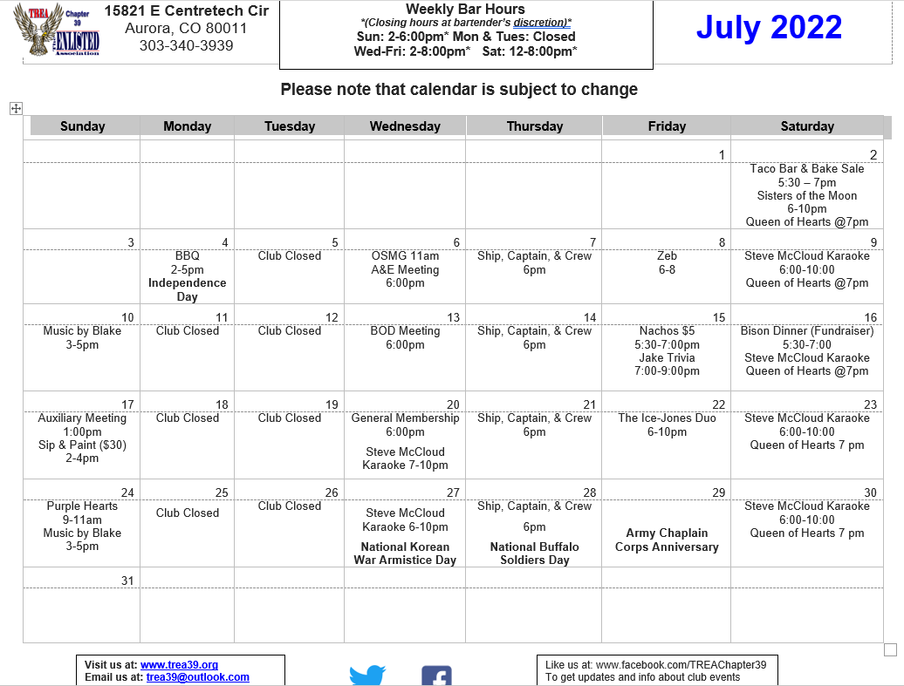

Slide 5
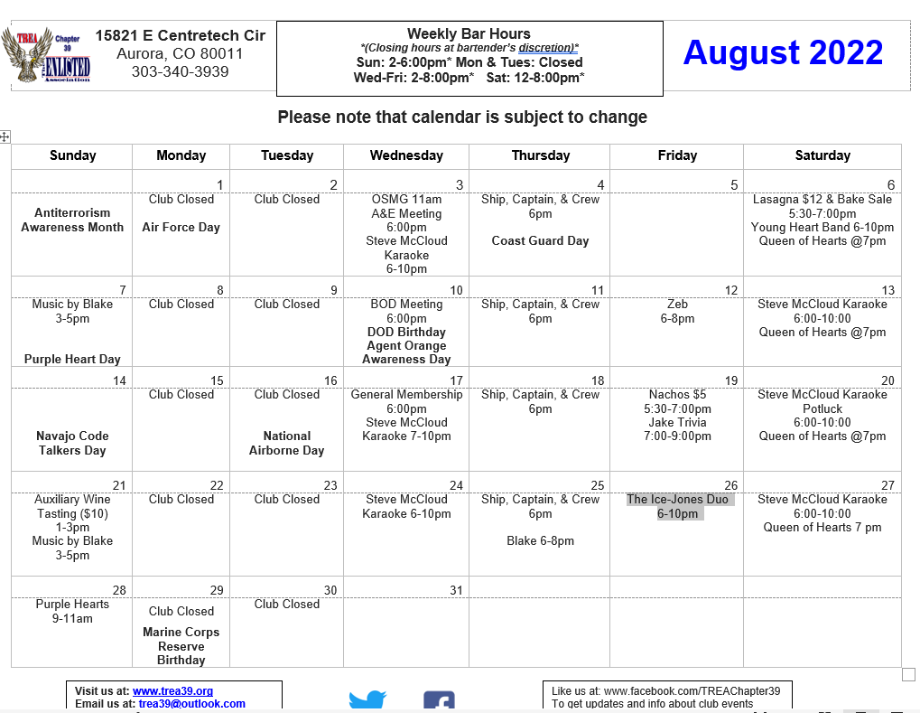

Slide 6
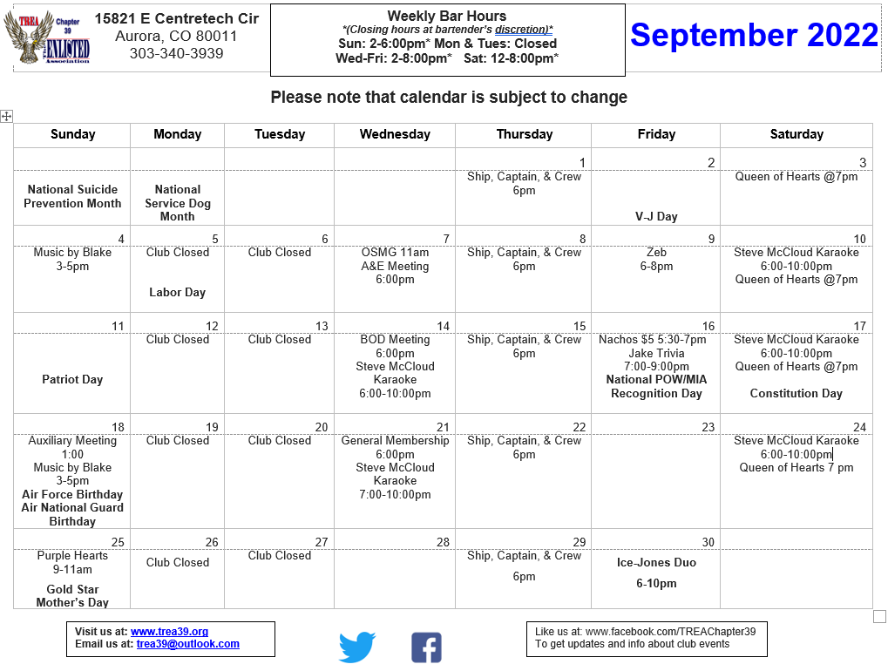
"People say money is not the key to happiness, but I have always figured if you have enough money, you can have a key made." —Joan Rivers

